Slide 1
Advanced Web Development (AWD) course-CS163
Dr Mandeep Kaur
Department of Computer Science and Engineering
Chitkara University, Punjab

Slide 2
Java scripting Advanced concept/closure
Revising basic concept of JavaScript
Function Hoisting
Function within Function
Function Expressions
Passing function as arguments
Mouse and Keyboard Events
Propagation of Event
Closures, const and let
Let in for loops
Arrow Functions
Bindings in Arrow Function

Slide 3
Intro to JavaScript
JavaScript is an object-based scripting language that is lightweight and cross-platform.
JavaScript is used to create interactive websites.
It is mainly used for:
Client-side validation
Dynamic drop-down menus
Displaying date and time
Displaying popup windows and dialog boxes (like alert dialog box, confirm dialog box and prompt dialogbox)
Displaying clocks etc.

Slide 4
JavaScript
JavaScript is one of the 3 languages all web developers must learn.
HTML to define the content of web pages
CSS to specify the layout of web pages
JavaScript to program the behavior of web pages
JavaScript is already running in your browser on your computer, on your tablet, and on your smart-phone.
JavaScript is free to use for everyone.

Slide 5
Embedding JavaScript in HTML
Script tag specifies the usage of JavaScript.
<SCRIPT> tag is an extension to HTML,
JavaScript code is inserted between <script> and </script> tags.
<SCRIPT>
JavaScript statements...
</SCRIPT>
A document can have multiple <SCRIPT> tags, and each can enclose any number of JavaScript statements.
Scripts can be placed in the <body>, or in the <head> section of an HTML page, or in both.

Slide 6
My First JavaScript
<html>
<head>
<title>java script</title>
</head>
<body>
<script>
document.write("Hello World!")
</script>
</body>
</html>

Slide 7

One of many JavaScript HTML methods is getElementById(). HTML element (with id="demo"), and changes the element content (innerHTML) to "Hello JavaScript":

Slide 8
JavaScript in <head>
a JavaScript function is placed in the <head> section of an HTML page.
The function is called when a button is clicked
Example
<!DOCTYPE html> <html> <head> <script> function myFunction() { document.getElementById("demo").innerHTML = "Paragraph changed."; } </script> </head> <body><h2>Demo JavaScript in Head</h2> <p id="demo">A Paragraph</p> <button type="button" onclick="myFunction()">Try it</button>
</body> </html>

Slide 9
JavaScript in <body>
Example a JavaScript function is placed in the <body> section of an HTML page.
The function is called when a button is clicked:
Example
<!DOCTYPE html> <html> <body> <h2>Demo JavaScript in Body</h2> <p id="demo">A Paragraph</p> <button type="button" onclick="myFunction()">Try it</button> <script> function myFunction() { document.getElementById("demo").innerHTML = "Paragraph changed."; } </script> </body> </html>

Slide 10
External JavaScript
Scripts can also be placed in external files:
function myFunction() { document.getElementById("demo").innerHTML = "Paragraph changed."; }
External scripts are practical when the same code is used in many different web pages.
JavaScript files have the file extension .js.
To use an external script, put the name of the script file in the src (source) attribute of a <script> tag:
<script src="myScript.js"></script>

Slide 11
Advantages
Placing scripts in external files has some advantages:
It separates HTML and code
It makes HTML and JavaScript easier to read and maintain
Cached JavaScript files can speed up page loads
To add several script files to one page - use several script tags:
<script src="myScript1.js"></script>

Slide 12
External References
an external script can be referenced in 3 different ways:
With a full URL (a full web address)
With a file path (like /js/)
Without any path
<script src="myScript1.js"></script

Slide 13
Variables
Variables are used to store data.
Keyword :var
VARIABLES
A variable's value can change during the script.
Refer to a variable by name to see its value or to change its value.
Name of a variable : a series of characters
letters, digits, underscores( _ ) and dollar signs($)
no whitespace
not begin with a digit
not a keyword.

Slide 14
Declare a variable:
Eg:
var name;
var size;(Semicolon is not mandatory)
var name, size;
Assign a value to a variable: var name = “Lisa”;
var size = 20;
Var
Let
Const
Let name=‘’
Let size=20

Slide 15
Let and const
Let Keyword
Introduced in 2015.
Variables defined with let cannot be Redeclared (i).
Variables defined with let must be Declared before use .
Variables defined with let have Block Scope (ii).
Example
let x = "John Doe"; let x = 0; // SyntaxError: 'x' has already been declared

Slide 16
Redeclaring a variable inside a block will not redeclare the variable outside the block
Example
let x = 10; // Here x is 10 { let x = 2; // Here x is 2 } // Here x is 10

Slide 17
Let and const
Const
Introduced in 2015.
Variables defined with const cannot be Redeclared.
Variables defined with const cannot be Reassigned.
Variables defined with const have Block Scope.
Example
const PI = 3.141592653589793; PI = 3.14; // This will give an error PI = PI + 10; // This will also give an error

Slide 18
const variables must be assigned a value when they are declared:
Example
const PI = 3.14159265359; (correct method)
const PI; (incorrect method) PI = 3.14159265359;

Slide 19
Let and const
Two important new JavaScript keywords are let and const.
These two keywords provide Block Scope in JavaScript.
Variables declared inside a { } block cannot be accessed from outside the block:
Example
{ let x = 2; } // x can NOT be used here

Slide 20
Local and Global Variables
JS belongs to local and global scope.
Local Variables
A function can access all variables defined inside the function.
local variable can only be used inside the function where it is defined.
It is hidden from other functions and other scripting code.
Local variables have short lives.
They are created when the function is invoked, and deleted when the function is finished.
Example
function myFunction() { let a = 4; return a * a; }

Slide 21
Global Variables
A function can also access variables defined outside the function.
variables can be used and changed by all scripts in the page.
Example
let a = 4; function myFunction() { return a * a; }
Global and local variables with the same name are different variables.
Modifying one, does not modify the other.
Global variables live until the page is discarded, like when you navigate to another page or close the window.

Slide 22
Variables created without a declaration keyword (var, let, or const) are always global, even if they are created inside a function.
Example
function myFunction() { a = 4; }

Slide 23
Data Types
To operate on variables, it is important to know something about the type.
Without data types, a computer cannot safely solve this:
JavaScript variables can hold different data types: numbers, strings, objects and more:
let length = 16; // Number let lastName = "Johnson"; // String let x = {firstName:"John", lastName:"Doe"}; // Object

Slide 24
Examples
let x = 16 + "Volvo"; 16volvo
let x = "16" + "Volvo"; 16Volvo
let x = 16 + "Volvo"; 16volvo
let x = "Volvo" + 16; volvo16
let x = 16 + 4 + "Volvo"; 20volvo
let x = "Volvo" + 16 + 4; volvo164

Slide 25
JavaScript Types are Dynamic
JavaScript has dynamic types. This means that the same variable can be used to hold different data types
let x; // Now x is undefined x = 5; // Now x is a Number x = "John"; // Now x is a String.
Pi=3.14;

Slide 26
JavaScript Numbers
JavaScript has only one type of numbers.
Numbers can be written with, or without decimals:
let x1 = 34.00; // Written with decimals let x2 = 34; // Written without decimals
Extra large or extra small numbers can be written with scientific (exponential) notation:
let y = 123e5; // 12300000 let z = 123e-5; // 0.00123
0.000000567
Let v =567e-6

Slide 27
JavaScript Strings
A string (or a text string) is a series of characters like "John Doe".
Strings are written with quotes. You can use single or double quotes:
let carName1 = "Volvo XC60"; // Using double quotes let carName2 = 'Volvo XC60'; // Using single quotes
use quotes inside a string, as long as they don't match the quotes surrounding the string:
let answer1 = "It's alright"; // Single quote inside double quotes let answer2 = "He is called 'Johnny'"; // Single quotes inside double quotes let answer3 = 'He is called "Johnny"'; // Double quotes inside single quotes

Slide 28
JavaScript Booleans
Booleans can only have two values: true or false
let x = 5; let y = 5; let z = 6; (x == y) // Returns true (x == z) // Returns false
Booleans are often used in conditional testing.

Slide 29
Undefined Vs Null in JavaScript
Undefined is a variable that has been declared but not assigned a value.
Null as an assignment value. So you can assign the value null to any variable which basically means it’s blank.
So by not declaring a value to a variable, JavaScript automatically assigns the value to undefined. However, when you assign null to a variable, you are declaring that this value is explicitly empty.
JavaScript will never automatically assign the value to null. That must be done by you in your code.
Example
let name // undefined
let iter =null; // null

Slide 30
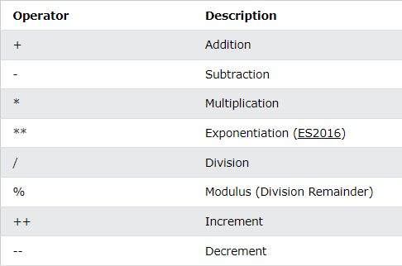
operators
Arithmetic Operators

Slide 31
String Operators
The + operator can also be used to add (concatenate) strings.
let text1 = "John"; let text2 = "Doe"; let text3 = text1 + " " + text2;
John Doe
The += assignment operator can also be used to add (concatenate) strings.
let text1 = "What a very "; text1 += "nice day";

Slide 32
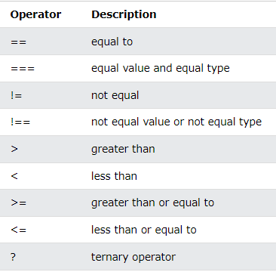
JavaScript Comparison Operators

Slide 33
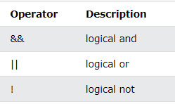
JavaScript Logical Operators

Slide 34
Operators and Operands
The numbers are called operands.
The operation performed between the two operands is defined by an operator.

Slide 35
Type Coercion
Type Coercion refers to the process of automatic or implicit conversion of values from one data type to another.
This includes conversion from Number to String, String to Number, Boolean to Number etc.
when different types of operators are applied to the values.

Slide 36
Conditionals
Conditional statements are used to perform different actions based on different conditions.
Use if to specify a block of code to be executed, if a specified condition is true.
Use else to specify a block of code to be executed, if the same condition is false
Use else if to specify a new condition to test, if the first condition is false
Use switch to specify many alternative blocks of code to be executed

Slide 37
if Statement
Use if to specify a block of code to be executed, if a specified condition is true.
if is in lowercase letters
Syntax
if(condition) { // block of code to be executed if the condition is true }
Example
if (hour < 18) { greeting = "Good day"; }

Slide 38
else Statement
if (condition) { // block of code to be executed if the condition is true } else { // block of code to be executed if the condition is false
}
Example 12
if (hour < 18) { greeting = "Good day"; } else { greeting = "Good evening"; }

Slide 39
else if Statement
Use the else if statement to specify a new condition if the first condition is false.
Syntax
if (condition1) { // block of code to be executed if condition1 is true } else if (condition2) { // block of code to be executed if the condition1 is false and condition2 is true } else { // block of code to be executed if the condition1 is false and condition2 is false }

Slide 40
Example
if (time < 10) { greeting = "Good morning"; } else if (time < 20) { greeting = "Good day"; } else { greeting = "Good evening"; }

Slide 41
Switch Statement
The switch statement is used to perform different actions based on different conditions.
Use the switch statement to select one of many code blocks to be executed.
Syntax
switch(expression) { case x: // code block break; case y: // code block break; default: // code block }

Slide 42
how switch statement works
The switch expression is evaluated once.
The value of the expression is compared with the values of each case.
If there is a match, the associated block of code is executed.
If there is no match, the default code block is executed.
When JavaScript reaches a break keyword, it breaks out of the switch block.
This will stop the execution inside the switch block.
It is not necessary to break the last case in a switch block. The block breaks (ends) there anyway.

Slide 43
Loop
Loops can execute a block of code a number of times.
Loops are handy, if you want to run the same code over and over again, each time with a different value.
text += cars[0] + "<br>"; text += cars[1] + "<br>"; text += cars[2] + "<br>"; text += cars[3] + "<br>"; text += cars[4] + "<br>"; text += cars[5] + "<br>";
for (let i = 0; i < cars.length; i++) { text += cars[i] + "<br>"; }

Slide 44
Kinds of Loops
JavaScript supports different kinds of loops:
for - loops through a block of code a number of times
for/in - loops through the properties of an object
for/of - loops through the values of an iterable object
while - loops through a block of code while a specified condition is true
do/while - also loops through a block of code while a specified condition is true

Slide 45
syntax
for (statement 1; statement 2; statement 3) { // code block to be executed }
Statement 1 is executed (one time) before the execution of the code block.
Statement 2 defines the condition for executing the code block.
Statement 3 is executed (every time) after the code block has been executed.
for (let i = 0; i < 6; i++) { text += "The number is " + i + "<br>"; }

Slide 46
For In
The JavaScript for in statement loops through the properties of an Object:
Syntax
for (key in object) { // code block to be executed }
Example
const person = {fname:"John", lname:"Doe", age:25}; let text = ""; for (let x in person) { text += person[x]; }

Slide 47
The for in loop iterates over a person object
Each iteration returns a key (x)
The key is used to access the value of the key
The value of the key is person[x]

Slide 48
For Of Loop
for of statement loops through the values of an iterable object.
It lets you loop over iterable data structures such as Arrays, Strings, Maps, NodeLists, and more:
Syntax
for (variable of iterable) { // code block to be executed }
variable - For every iteration the value of the next property is assigned to the variable. Variable can be declared with const, let, or var.
iterable - An object that has iterable properties.

Slide 49
Example
const cars = ["BMW", "Volvo", "Mini"]; let text = ""; for (let x of cars) { text += x; }

Slide 50
Looping over a String Example
let language = "JavaScript"; let text = ""; for (let x of language) { text += x; }

Slide 51
Let in for loops
using let, the variable declared in the loop does not redeclare the variable outside the loop.
When let is used to declare the i variable in a loop, the i variable will only be visible within the loop
Example
let i = 5; for (let i = 0; i < 10; i++) { // some code }

Slide 52
While Loop
The while loop loops through a block of code as long as a specified condition is true.
Syntax
while (condition) { // code block to be executed }
Example
while (i < 10) { text += "The number is " + i; i++; }

Slide 53
Do While Loop
do while loop is a variant of the while loop. This loop will execute the code block once, before checking if the condition is true, then it will repeat the loop as long as the condition is true.
Syntax
do { // code block to be executed } while (condition);
The loop will always be executed at least once, even if the condition is false, because the code block is executed before the condition is tested.
do { text += "The number is " + i; i++; } while (i < 10);

Slide 54
Javascript functions and Arrays
Functions
Variable Length Arguments
Function Hoisting
Functions and Scope
Function within Function
Function Expressions
Function Declaration vs Expressions
Passing function as arguments
Arrays
Functions on Arrays
Splice function
Iterating over arrays

Slide 55
Why functions? (Scope)
You can reuse code:
Define the code once, and use it many times.
You can use the same code many times with different arguments, to produce different results.

Slide 56
Function Declaration
JavaScript functions are defined with the function keyword.
You can use a function declaration or a function expression.
function is a block of code designed to perform a particular task.
function is executed when something to calls it.
Syntax
function name(parameter1, parameter2, parameter3) { // code to be executed }
Declared functions are not executed immediately.
They are "saved for later use", and will be executed later, when they are called upon.

Slide 57
Functions
function is defined with the function keyword, followed by a name, followed by parentheses ().
Function names can contain letters, digits, underscores, and dollar signs.
The parentheses may include parameter names separated by commas: (parameter1, parameter2, ...)
The code to be executed, by the function, is placed inside curly brackets: {}
Semicolons are used to separate executable JavaScript statements.
function declaration is not an executable statement, it is not common to end it with a semicolon.

Slide 58
Function parameters are listed inside the parentheses () in the function definition.
Function arguments are the values received by the function when it is called.
Inside the function, the arguments (the parameters) behave as local variables.
Example
function myFunction(p1, p2) { return p1 * p2; // The function returns the product of p1 and p2 }

Slide 59
Function Call
The code inside the function will execute when "something" calls the function:
When an event occurs (when a user clicks a button)
When it is called from JavaScript code
Automatically self called.

Slide 60
Function Return
When JavaScript reaches a return statement, the function will stop executing.
If the function was called from a statement, JavaScript will "return" to execute the code after the calling statement.
Functions often compute a return value. The return value is "returned" back to the "caller":
Example
let x = myFunction(4, 3); // Function is called, return value will end up in x function myFunction(a, b) { return a * b; // Function returns the product of a and b }

Slide 61
() Operator calls the Function
Example shows, toCelsius refers to the function object, and toCelsius() refers to the function result.
Accessing a function without () will return the function object instead of the function result.
function toCelsius(fahrenheit) { return (5/9) * (fahrenheit-32); } document.getElementById("demo").innerHTML = toCelsius();

Slide 62
Functions Used as Variable Values
Functions can be used the same way as you use variables, in all types of formulas, assignments, and calculations.
Instead of using a variable to store the return value of a function:
let x = toCelsius(77); let text = "The temperature is " + x + " Celsius";
You can use the function directly, as a variable value:
let text = "The temperature is " + toCelsius(77) + " Celsius";

Slide 63
Local Variables
Variables declared within a JavaScript function, become LOCAL to the function.
Local variables can only be accessed from within the function.
local variables are only recognized inside their functions, variables with the same name can be used in different functions.
Local variables are created when a function starts, and deleted when the function is completed.
Example
// code here can NOT use carName function myFunction() { let carName = "Volvo"; // code here CAN use carName } // code here can NOT use carName

Slide 64
Anonymous function
After a function expression has been stored in a variable, the variable can be used as a function:
const x = function (a, b) {return a * b}; let z = x(4, 3);
The function above is actually an anonymous function (a function without a name).
Functions stored in variables do not need function names. They are always called using the variable name.
The function above ends with a semicolon because it is a part of an executable statement.

Slide 65
Function Expressions
A JavaScript function can also be defined using an expression.
A function expression can be stored in a variable:
After a function expression has been stored in a variable, the variable can be used as a function:
const x = function (a, b) {return a * b};
document.getElementById("demo").innerHTML = x(4, 3);

Slide 66
Passing function as arguments
JavaScript functions can be used as values:
Example
function myFunction(a, b) { return a * b; } let x = myFunction(4, 3);

Slide 67
Variable Length Arguments
The arguments.length property returns the number of arguments received when the function was called.
Example
function myFunction(a, b) { return arguments.length; }

Slide 68
Function Hoisting
Hoisting is JavaScript's default behavior of moving declarations to the top of the current scope.
Hoisting applies to variable declarations and to function declarations.
JavaScript functions can be called before they are declared:
function | variable
myFunction(5); function myFunction(y) { return y * y; } | let x; // Declare x x = 5; // Assign 5 to x elem = document.getElementById("demo"); // Find an element elem.innerHTML = x; // Display x in the element

Slide 69
Function within Function
Nested Functions
All functions have access to the global scope.
In JavaScript, all functions have access to the scope "above" them.
JavaScript supports nested functions. Nested functions have access to the scope "above" them.
In this example, the inner function plus() has access to the counter variable in the parent function:
This could have solved the counter dilemma, if we could reach the plus() function from the outside.
We also need to find a way to execute counter = 0 only once.

Slide 70
function add() { let counter = 0; function plus() {counter += 1;} plus(); return counter; }
const add = (function () { let counter = 0; return function () {counter += 1; return counter} })(); add(); add(); add(); // the counter is now 3

Slide 71
Nested Functions
JavaScript supports nested functions. Nested functions have access to the scope "above" them.
example,
function add() { let counter = 0; function plus() {counter += 1;} plus(); return counter; }
Inner function plus() has access to the counter variable in the parent function:
This could have solved the counter dilemma, if we could reach the plus() function from the outside.
We also need to find a way to execute counter = 0 only once. We need a closure.

Slide 72
JavaScript Closures
Closure is a function having access to the parent scope, even after the parent function has closed.
Example
const add = (function () { let counter = 0; return function () {counter += 1; return counter} })(); add(); add(); add();

Slide 73
The variable add is assigned to the return value of a self-invoking function.
The self-invoking function only runs once. It sets the counter to zero (0), and returns a function expression.
This way add becomes a function.
it can access the counter in the parent scope.
This is called a JavaScript closure.
It makes it possible for a function to have "private" variables.
The counter is protected by the scope of the anonymous function, and can only be changed using the add function.

Slide 74
Arrays
An array is a special variable, which can hold more than one value:
If you have a list of items, storing in single variables could look like this.
Syntax:
const array_name = [item1, item2, ...];
An array can hold many values under a single name, and you can access the values by referring to an index number.
Array elements are accessed using their index number:
Array indexes start with 0:
[0] is the first array element [1] is the second [2] is the third ...

Slide 75
Why array?
If you have a list of items, storing the list in single variables could look like this.
let car1 = "Saab"; let car2 = "Volvo"; let car3 = "BMW";
However, what if you want to loop through the cars and find a specific one? And what if you had not 3 cars, but 300?
The solution is an array!
An array can hold many values under a single name, and you can access the values by referring to an index number.
const cars = ["Saab", "Volvo", "BMW"];

Slide 76
Functions on Arrays
Converting Arrays to Strings
toString() converts an array to a string of array values.
join() method also joins all array elements into a string.
Popping and Pushing
pop() method removes the last element from an array.
push() method adds a new element to an array (at the end).
Shifting Elements
Shifting is equivalent to popping, but working on the first element instead of the last.
shift() method removes the first array element and "shifts" all other elements to a lower index.
unshift() method adds a new element to an array (at the beginning), and "unshifts" older elements:

Slide 77
Changing Elements
Array elements are accessed using their index number.
example
const fruits = ["Banana", "Orange", "Apple", "Mango"]; fruits[0] = "Kiwi";
JavaScript Array length
length property provides an easy way to append a new element to an array:
const fruits = ["Banana", "Orange", "Apple", "Mango"]; fruits[fruits.length] = "Kiwi";

Slide 78
Splice function
splice() method adds new items to an array.
splice() to remove elements without leaving "holes" in the array:
const fruits = ["Banana", "Orange", "Apple", "Mango"]; fruits.splice(2, 0, "Lemon", "Kiwi");
First parameter (2) defines the position where new elements should be added (spliced in).
Second parameter (0) defines how many elements should be removed.
The rest of the parameters ("Lemon" , "Kiwi") define the new elements to be added.

Slide 79
Iterating over arrays
Array iteration methods operate on every array item.
forEach() method calls a function once for each array element.
Example
const numbers = [45, 4, 9, 16, 25]; let txt = ""; numbers.forEach(myFunction); function myFunction(value) { txt += value + "<br>"; }

Slide 80
Object and Timing Events
Objects
Square Bracket Notation
Deleting Properties
How are Objects Stored
Iterating Over Objects
Nested Objects
Arrays and Objects
Iterating over array using for in
Timing Events
Countdown Timer

Slide 81
Objects
In JavaScript, almost "everything" is an object.
Real Life Objects, Properties, and Methods
In real life, a person is an object.
A person
properties like name, age and color.
method is a function stored as a property.
create a JavaScript object with an object literal.
const person = {firstName:"John", lastName:"Doe", age:50, eyeColor:"blue"};
name:values pairs in JavaScript objects are called properties:

Slide 82
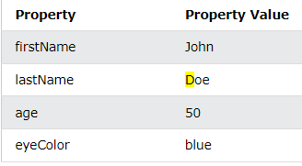
Object Properties

Slide 83
Square Bracket Notation
Access object properties in two ways.
Dot notation
objectName.propertyName
Example
person.lastName;
Square bracket notation.
objectName["propertyName“]
Example
person["lastName"];

Slide 84
Adding New Properties
You can add new properties to an existing object by simply giving it a value.
Assume that the person object already exists - you can then give it new properties:
Example
person.nationality = "English";

Slide 85
Deleting Properties
The delete keyword deletes a property from an object.
The delete keyword deletes both the value of the property and the property itself.
After deletion, the property cannot be used before it is added back again.
The delete operator is designed to be used on object properties. It has no effect on variables or functions. firstName: "John", lastName: "Doe", age: 50, eyeColor: "blue" }; delete person.age;

Slide 86
How are Objects Stored
Objects can also have methods.
Methods are actions that can be performed on objects.
Methods are stored in properties as function definitions.
A method is a function stored as a property.
const person = { firstName: "John", lastName : "Doe", id : 5566, fullName : function() { return this.firstName + " " + this.lastName; } };

Slide 87
The this Keyword
In a function definition, this refers to the "owner" of the function.
In the example above, this is the person object that "owns" the fullName function.
In other words, this.firstName means the firstName property of this object.

Slide 88
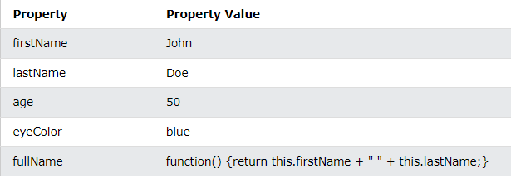

Slide 89
Iterating Over Objects
JavaScript for in statement loops through the properties of an Object:
Syntax
for (key in object) { // code block to be executed }
Example
const person = {fname:"John", lname:"Doe", age:25}; let text = ""; for (let x in person) { text += person[x]; }

Slide 90
Nested Objects
Values in an object can be another object.
access nested objects using the dot notation or the bracket notation.
Example
myObj = { name:"John", age:30, cars: { car1:"Ford", car2:"BMW", car3:"Fiat" } }

Slide 91
myObj.cars.car2;
myObj.cars["car2"];
myObj["cars"]["car2"];

Slide 92
Nested Arrays and Objects
Values in objects can be arrays, and values in arrays can be objects.
Example
const myObj = { name: "John", age: 30, cars: [ {name:"Ford", models:["Fiesta", "Focus", "Mustang"]}, {name:"BMW", models:["320", "X3", "X5"]}, {name:"Fiat", models:["500", "Panda"]} ] }

Slide 93
Iterating over array using for in
To access arrays inside arrays, use a for-in loop for each array.
Example
for (let i in myObj.cars) { x += "<h1>" + myObj.cars[i].name + "</h1>"; for (let j in myObj.cars[i].models) { x += myObj.cars[i].models[j]; } }

Slide 94
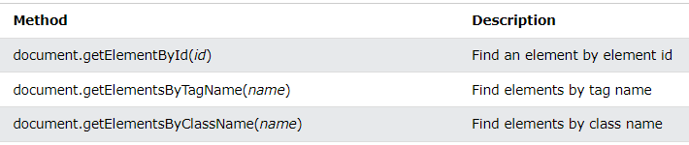
Fetching Elements
Example shows how you can use the document object to access and manipulate HTML

Slide 95
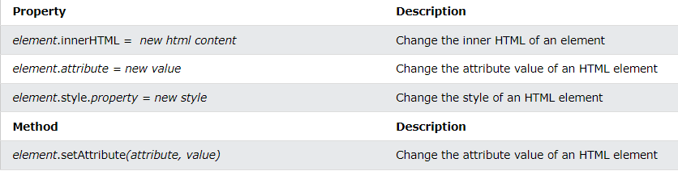
Changing HTML Elements

Slide 96
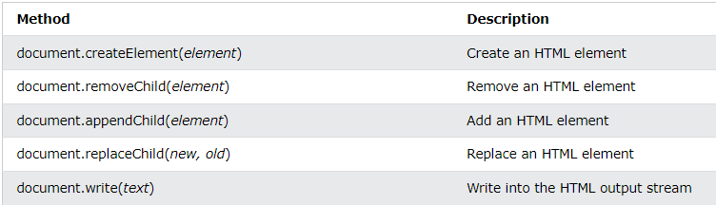
Adding and Deleting Elements

Slide 97
Event Handling
a function is called from the event handler:

Slide 98
External JS File
External scripts are practical when the same code is used in many different web pages.
JavaScript files have the file extension .js.
To use an external script, put the name of the script file in the src (source) attribute of a <script> tag:
place an external script reference in <head> or <body> as you like.
The script will behave as if it was located exactly where the <script> tag is located.
External scripts cannot contain <script> tags.
Example-myScript.js
function myFunction() { document.getElementById("demo").innerHTML = "Paragraph changed."; }

Slide 99
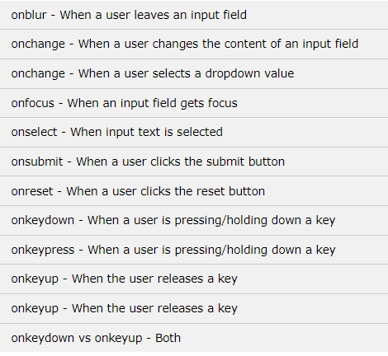
Keyboard Events

Slide 100
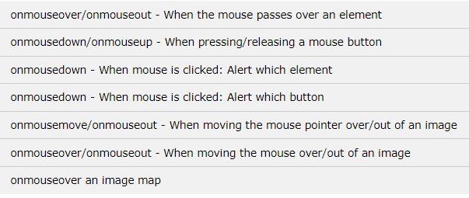
Mouse Events
Dr. Mandeep Kaur Group G3, G6 & G7

Slide 101
Propagation of Event
stopPropagation() Event Method
prevents propagation of the same event from being called.
Propagation means bubbling up to parent elements or capturing down to child elements.
Syntax
event.stopPropagation()

Slide 102
Strict Mode
“use strict" is to indicate that the code should be executed in "strict mode".
With strict mode, you can not use undeclared variables.
All modern browsers support "use strict" except Internet Explorer 9 and lower.

Slide 103
Arrow Functions

Slide 104
Bindings in Arrow Function

